Slide 1

AI Stock Insights
Executive Summary
Project Overview: Develop a user-input based stock analysis tool focused on AI companies, providing stock recommendations based on user-defined risk/return criteria, historical trends, and future price predictions.
.

Slide 2

Executive Summary
Project Overview: Develop comprehensive stock analysis code that provides:
Insights on the best day of the week to purchase stock
Historical trend analysis
Comparison of stocks to each other
Future price predictions specifically targeting AI companies.

Slide 3
The Fantastic Six
Ryan Brown
Contributor
Data Cleaning
Danny Srour
Read.md file
Visualization
Github Version control
Daniel Liu
Contributor
Coder
Caleb Kelson
Contributor
Visualization
Austin Cappetta
Contributor
Visualization
Cathy Schassberger
Contributor
Presentation

Slide 4
Project Approach
Our group’s approach to achieving the project goals involved several structured and collaborative steps:
Initial planning and goal setting
Outline the primary objective:
Develop stock analysis code focused on AI companies. This tool would provide analysis so a reader could identify stock recommendations based on historical trends, stock comparison, future price predictions and the best day of the week to make a purchase.
Stock Selection
Six prominent AI-related companies were the focus:
NVIDIA, Amazon, Oracle, Meta Platforms, Alphabet Inc and Tesla. The companies were selected based on their significant impact on the AI industry.
Data Collection
Five years of historical data from November 2019 to November 2024.
Data included prices and relevant financial metrics for the selected companies.
Reliable financial databases were used to ensure the accuracy and completeness of the data.
Data Cleaning
The data was meticulously cleaned to handle missing values, outliers and inconsistencies. This step was
crucial to ensure that our analysis and predictions would be based on high-quality and reliable data.

Slide 5
Data Exploration
Data was explored to understand trends, patterns and relationships. This step involved visualizing the data, performing statistical analyses, and identifying key insights.
Visualization and reporting
Interactive charts and graphs were created to visualize stock performance and trends.
The visualizations help users make informed decisions by providing clear and comprehensive insights.
Testing and refinement
Thorough testing was conducted to ensure the code’s functionality and accuracy.
Team feedback was gathered and incorporated to refine and improve the code.
Deployment and Future Enhancements
The code was finalized and deployed.
Planning future enhancements were discussed such as integrating additional AI companies, adding prediction algorithms, and incorporating user interaction.
The structured approach ensured that we stayed focused on our goals, collaborated effectively, and delivered a robust Stock analysis code.

Slide 6
Snippet of the read me

Slide 7

Major Inconsistency: The Stock Split
Nvidea Add the right code here
starting_price = nvda_df.iloc[0]['close'] nvda_df['daily_pct_change'] = nvda_df['close'].pct_change() nvda_df['cumm_pct_change'] = nvda_df['close'] / starting_price - 1.0 nvda_df.head(5)
daily_df['date'] = daily_df.index.date daily_df['close'] = daily_df.apply(lambda x: adjust_for_splits(symbol, x['date'], x['4. close']), axis= 1) display(daily_df.head(5)) display(daily_df.tail(5))

Slide 8
Stock Split visualization

Slide 9
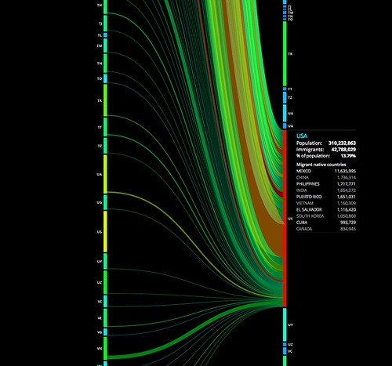
Explorations
and
Visualizations Representations

Slide 10
Question 1 - The best day of the week to purchase stock? Should be add sell?
NEED THIS VISULAZATION
Need to provide the analysis

Slide 11
Question 2 – What are the historical trends
Visualizations
Need to provide the analysis

Slide 12
Question 3 – How do the stocks compare against each other?
Visualizations
Need to provide the analysis

Slide 13
Question 4 – Future stock price estimates
Visualizations
Need to provide the analysis

Slide 14

Future Development
Unanswered Questions: Investigate the impact of external factors (e.g., market news, geopolitical events) on stock prices.
Improvements: Enhance the prediction models with more advanced algorithms and larger datasets.
Results and Conclusions
Key Findings: Highlight the historical trends and performance of the selected stocks.
Investment Insights: Provide insights on the best times to buy/sell stocks and comparative performance.
Does this outline align with your vision for the project? Would you like to dive deeper into any specific section?

Slide 15

Need to summarize our findings.

Slide 16

Questions?

